Slide 1
V. Fourier transform
5-1. Definition of Fourier Transform
* The Fourier transform of a function f(x) is
defined as
The inverse Fourier transform,

Slide 2
3-D: the Fourier transform of a function f(x,y,z)
Note that
ux+vy+wz: can be considered as a scalar
product of
if the following conditions are met!

Slide 3
Therefore,
the vector may be considered as a vector in “Fourier transform space”
The inverse Fourier transform in 3-D space:

Slide 4
5-2. Dirac delta function
Generalized function: the limit of a sequence
of functions
Start with the normalized Gaussian functions
σ : standard Gaussian width parameter

Slide 5
Gaussian Integration:
Star from
dxdy: integration over a surface →
change to polar coordinate (r, θ)
rdθ
r
dr
1/2

Slide 6
Let
Consider sequence of function

Slide 7
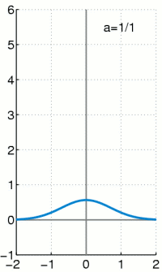
a = 1/n
http://en.wikipedia.org/wiki/Dirac_delta_function

Slide 8
What happen when n = ∞
(a)
(b)
(c)
(d)
the width of the center peak = 0
The sequence only useful if it appears as part
of an integral, e.g.
Only f(0) is important

Slide 9
Dirac Delta Function: limit of Gaussian
distribution function
There are infinitely many sequences that can
be used to define the delta function

Slide 10
Dirac delta function is an even function
Note that
=
≡ y

Slide 11
Similar
Compare to

Slide 12
5-3. A number of general relationships may
be written for any function f(x)
real or complex.
Real Space | Fourier Transform Space
f(x) | F(u)
f(-x) | -F(-u)
f(ax) | F(u/a)/a
f(x)+g(x) | F(u)+G(u)
f(x-a) | e^{-2πiau}F(u)
df(x)/dx | 2πiuF(u)
d^{n}f(x)/dx^{n} | (2πiu)^{n}F(u)

Slide 13
Example
(1)
Set X = ax

Slide 14
(2)
Set X = x - a

Slide 15
(3)

Slide 17
5-4. Fourier transform and diffraction
(i) point source or point aperture
A small aperture in 1-D: δ (x) or δ (x-a).
Fourier transform the function →
Fraunhofer diffraction pattern
For δ (x):
= 1
= 1
= 1
The intensity is proportional

Slide 18
For δ (x-a):
Set X = x-a
The intensity is proportional
The difference between the point source at
x = 0 and x = a is the phase difference.

Slide 19
(ii) a slit function
c.f. the kinematic diffraction from a slit

Slide 20
c.f. the kinematic diffraction from a slit
Chapter 4 ppt p.28

Slide 21
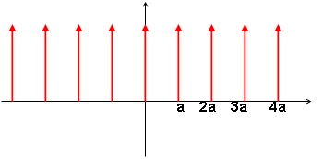
(iii) a periodic array of narrow slits

Slide 23
Discussion
For
= 1
For
It occurs at the condition
h: integer

Slide 24
In other words,
Note that
Set

Slide 25
The Fourier transform of f(x) →
where a > 0
Hence, the Fourier transform of a set of
equally spaced delta functions with a period
a in x space
→ a set of equally spaced delta functions
with a period 1/a in u space

Slide 26
Similarly，a periodic 3-D lattice in real space;
(a, b, c)
This is equivalent to a periodic lattice in
reciprocal lattice (1/a 1/b 1/c).

Slide 27
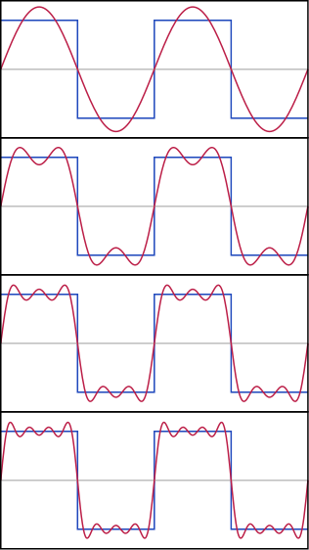
(iv) Arbitrary periodic function
http://en.wikipedia.org/wiki/Fourier_series

Slide 28
Hence，the F(u) ；i.e. diffracted amplitude,
is represented by a set of delta functions
equally spaced with separation 1/a and each
delta function has “weight”, F_{h}, that is equal
to the Fourier coefficient.

Slide 29
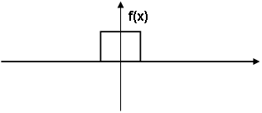
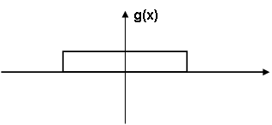
5-5. Convolution
The convolution integral of f(x) and g(x) is
defined as

Slide 30
examples：
(1) prove that f(x) ∗ g(x) = g(x) ∗ f(x)
Set Y = x - X

Slide 31
(2) Prove that
(3) Multiplication theorem
If
then
(4) Convolution theorem (proof next page)
If
then

Slide 32
Proof: Convolution theorem
= F(u)
= G(u)

Slide 33
Example：diffraction grating
a single slit or
ruling function
a set of N delta function

Slide 35
Supplement # 1
Fourier transform of a Gaussian function is
also a Gaussian function.
Suppose that f(x) is a Gaussian function
Define

Slide 36
Chapter 5 ppt
page 5
Gaussian Function
in u space

Slide 37
Standard deviation is defined as the range of the
variable (x or u) over which the function drops
by a factor of of its maximum value.

Slide 38
c.f

Slide 40
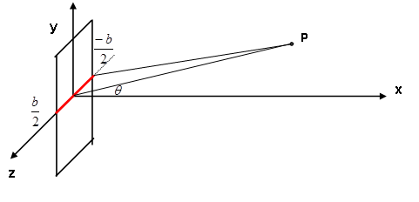
Supplement #2
Consider the diffraction from a single slit
The result from a single slit
The expression is the same as Fourier transform.

Slide 41
Supplement #3
Definitions in diffraction
Fourier transform and inverse Fourier transform
System 1
System 4
System 2
System 5
System 3
System 6

Slide 42
relationship among Fourier transform, reciprocal
lattice, and diffraction condition
System 1, 4
Reciprocal lattice
Diffraction condition

Slide 43
System 2, 3, 5, 6
Reciprocal lattice
Diffraction condition

